Slide 1
Solutions

Slide 2
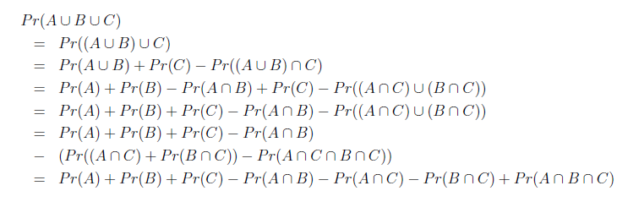
1.

Slide 3
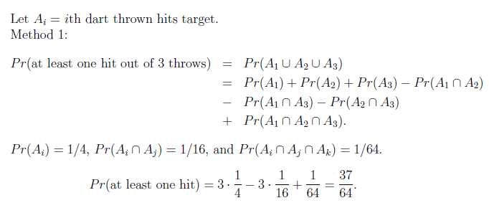
3.
We are given a number of darts. When we throw a dart at a target, we have a probability of 1/4 of hitting the target. What is the probability of obtaining at least one hit if three darts are thrown?

Slide 4
4.
We have four boxes. Box 1 contains 2000 components of which 5% are defective. Box 2 contains 500 components of which 40% are defective. Box 3 and 4 contain 1000 each with 10% defective. We select at random of the boxes and we remove at random a single component.
What is the probability that the selected component is defective?
We saw that the selected component is defective. What is the probability that it came from Box 2?

Slide 6

An experiment consists of selecting two integers $(n,k)$ such that $0≤n<5$ and $0≤k<10$. How many outcomes are in the sample space?

Slide 7
An urn contains eight blue balls and four green balls. Three balls are drawn from this urn without replacement. We wish to compute the probability that all three balls are blue.

Slide 8
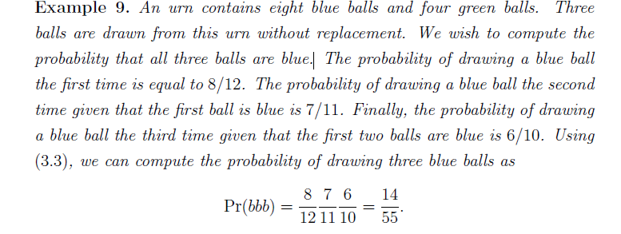
ans

Slide 9
7. John, a biochemist, designs a test for a latent disease. If a subject has the disease, the probability that the test results turn out positive is 0.95. Similarly, if a subject does not have the disease, the probability that the test results come up negative is 0.95. Suppose that one percent of the population is infected by the disease. We wish to find the probability that a person who tested positive has the disease.

Slide 10
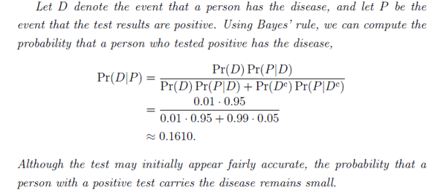

Slide 11
9. Two dice are rolled at the same time, a red die and a blue die.
Let A be the event that the number on the red die is odd. Let B be the event that the number on the red die is either two, three or four. Also, let C be the event that the product of the two dice is twelve.
Are these events pair-wise independent?
What about their independence in general?

Slide 12
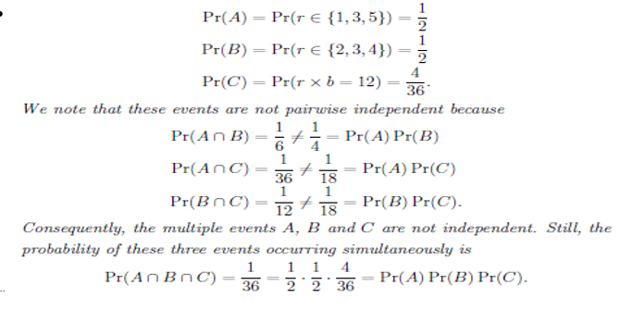

Slide 13
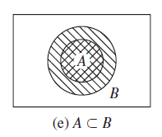
Prove that if A ⊂ B then Pr(A) ≤ Pr(B).
A is a subset of B if every element of A also belongs to B, that is, if
implies We say that “A is contained in B”

Slide 14
Can two events are independent if they are disjoint?

Slide 15
An urn contains two black balls and three white balls. Two balls are selected at random from the urn without replacement and the sequence of colors is noted. Find the probability that both balls are black.

Slide 16
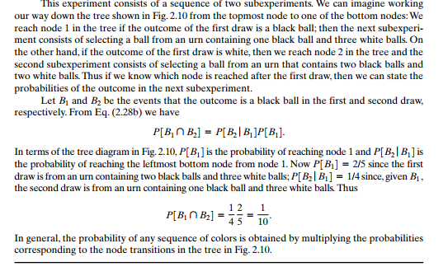

Slide 17
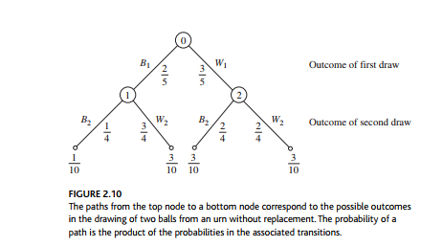

Slide 18
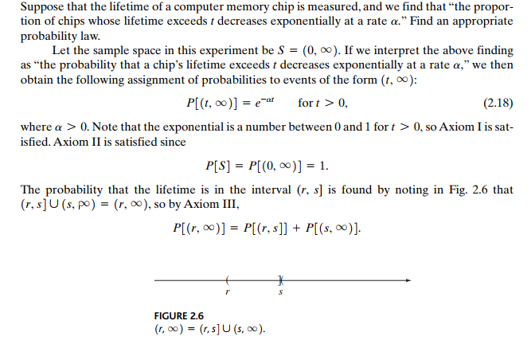


Slide 19
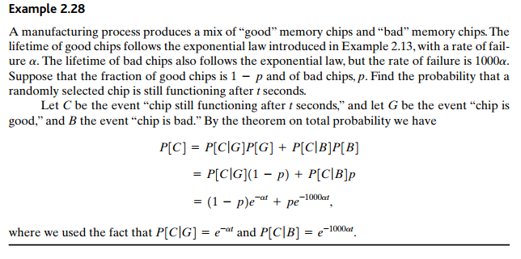

Slide 20
Consider a memory chips problem. A fraction p of the chips are bad and tend to fail much more quickly than good chips. Suppose that in order to “weed out” the bad chips, every chip is tested for t seconds prior to leaving the factory. The chips that fail are discarded and the remaining chips are sent out to customers. Find the value of t for which 99% of the chips sent out to customers are good.

Slide 21
